Slide 1

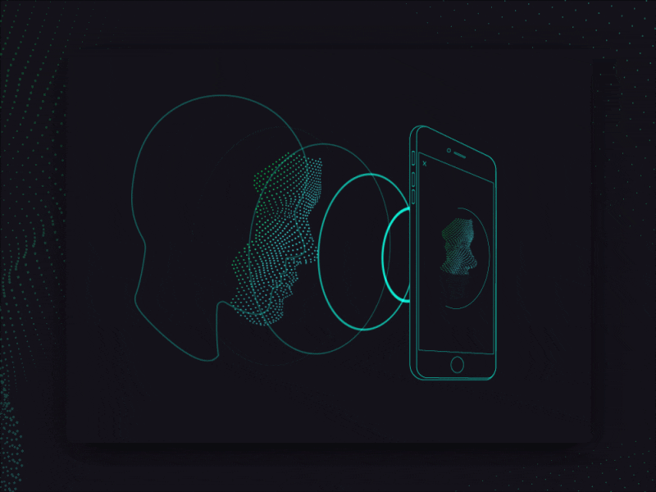
JourneyEase
(Face Recognition access control)
Code Mystics
Srushti Pophale
Sanika Nanavare
Shreya Jakapure

Slide 2
Problem Statement
Public transportation systems face challenges with boarding, fare evasion, security, and accessibility, impacting travel quality. Facial recognition technology offers swift boarding, fare protection, enhanced security, and improved accessibility for a seamless travel experience.
Boarding
Fare Evasion
Security
Availability
Delays
Revenue Loss
Safety Concerns
Limited Access

Slide 3
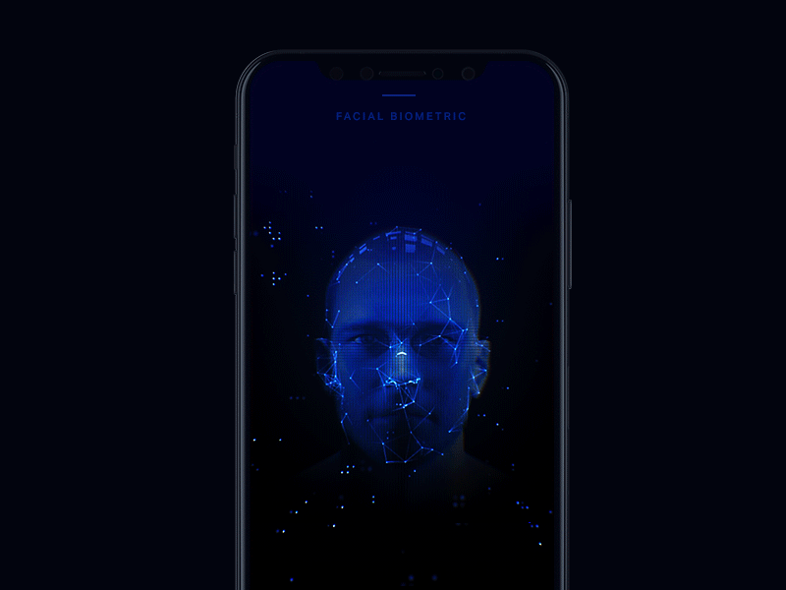
Solution
Seamless Entry
Fare Evasion detection
Facial Recognition replaces cards/tickets at entry points
Alerts authorities for immediate action, ensuring fair contribution
WHAT SETS US APART
WHAT SETS US APART
User Enrollment
Integration with payment systems
Provide facial images for secure boarding; transit agencies ensure privacy.
Link facial biometrics to payment accounts for automatic fare
deduction

Slide 4
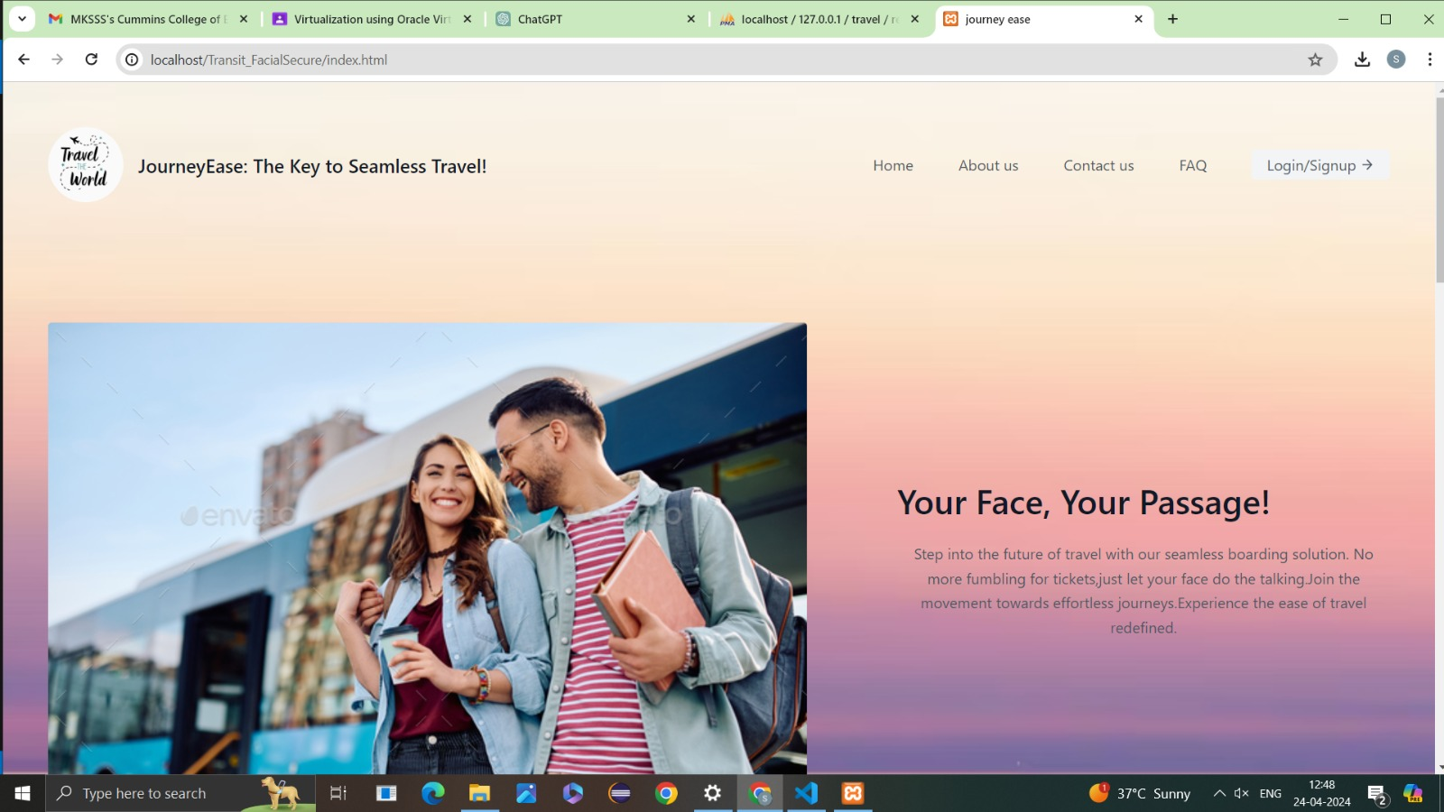
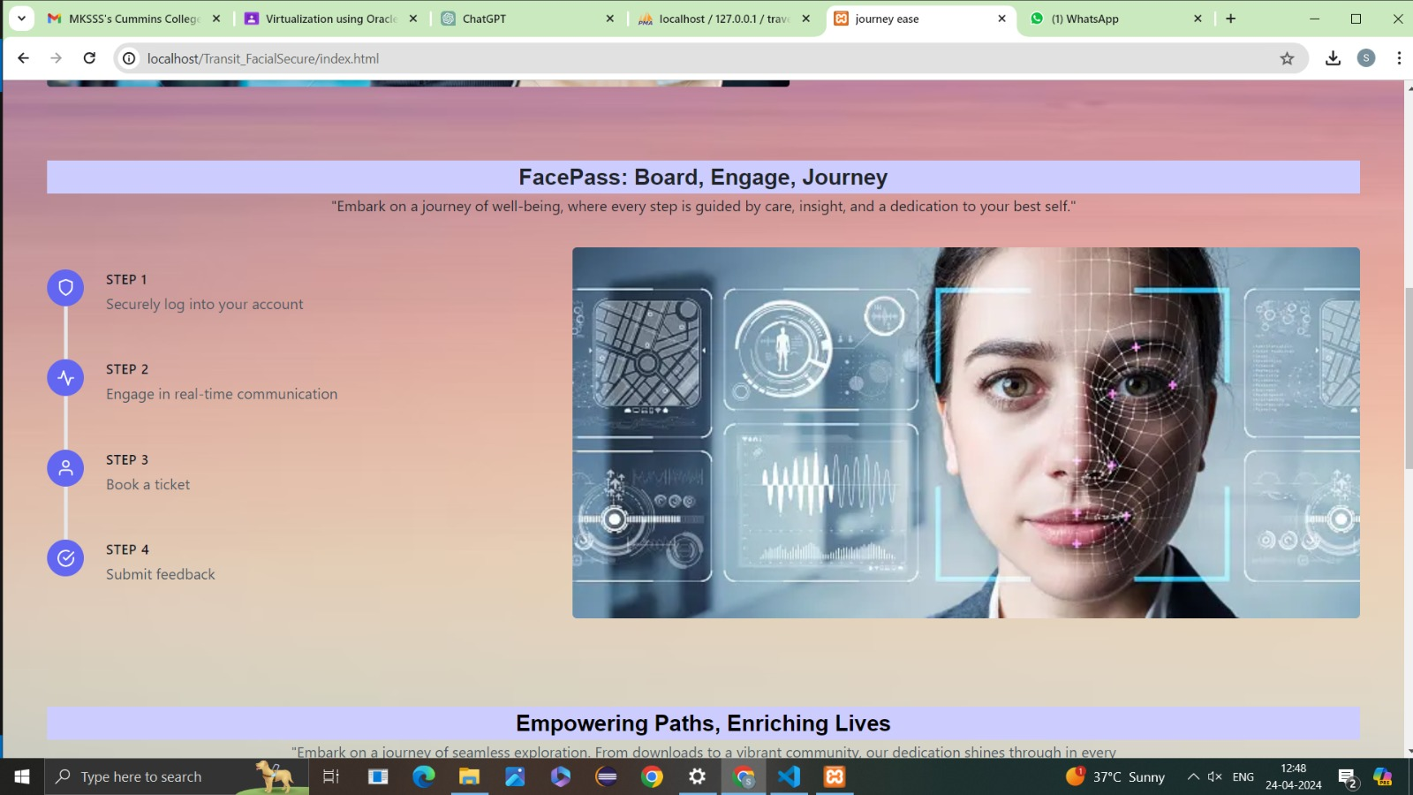
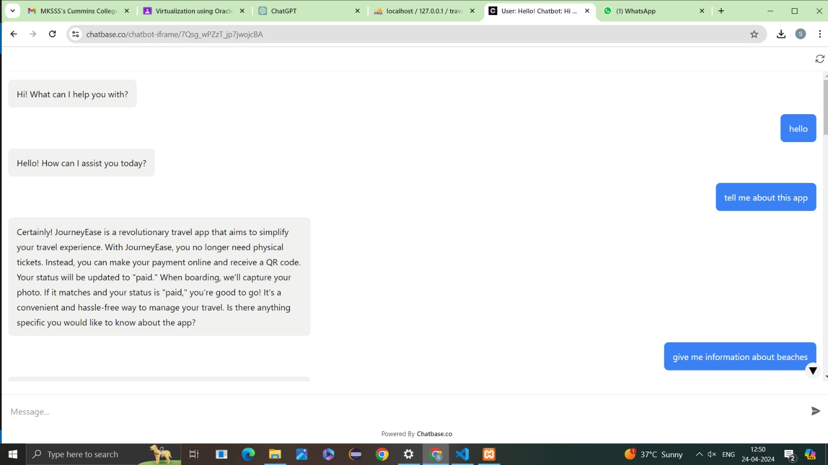
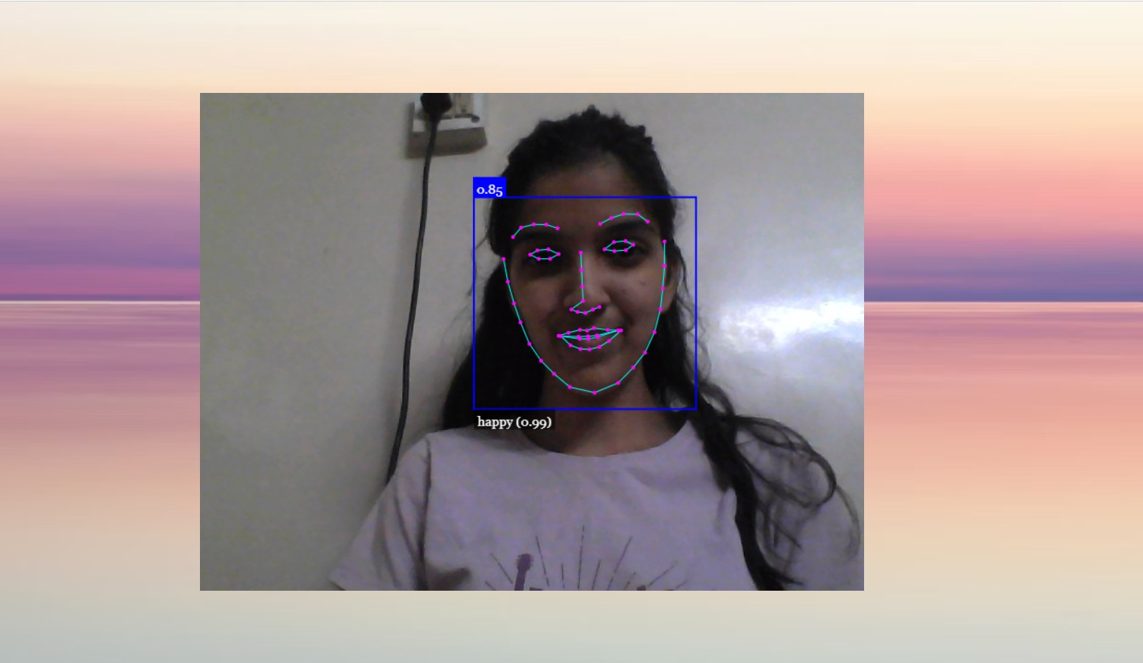
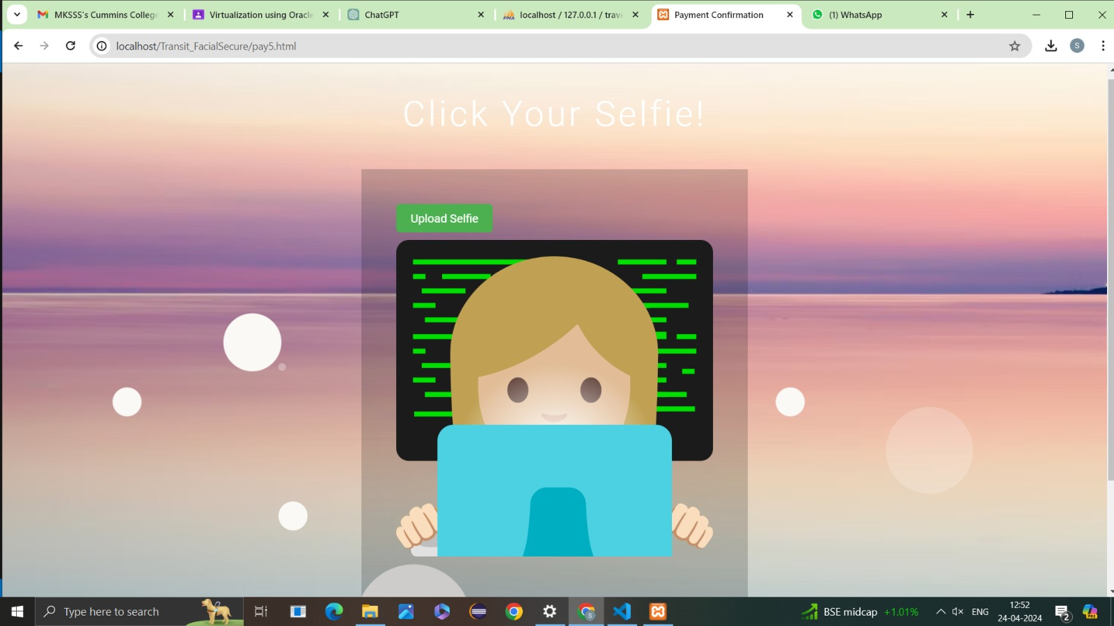
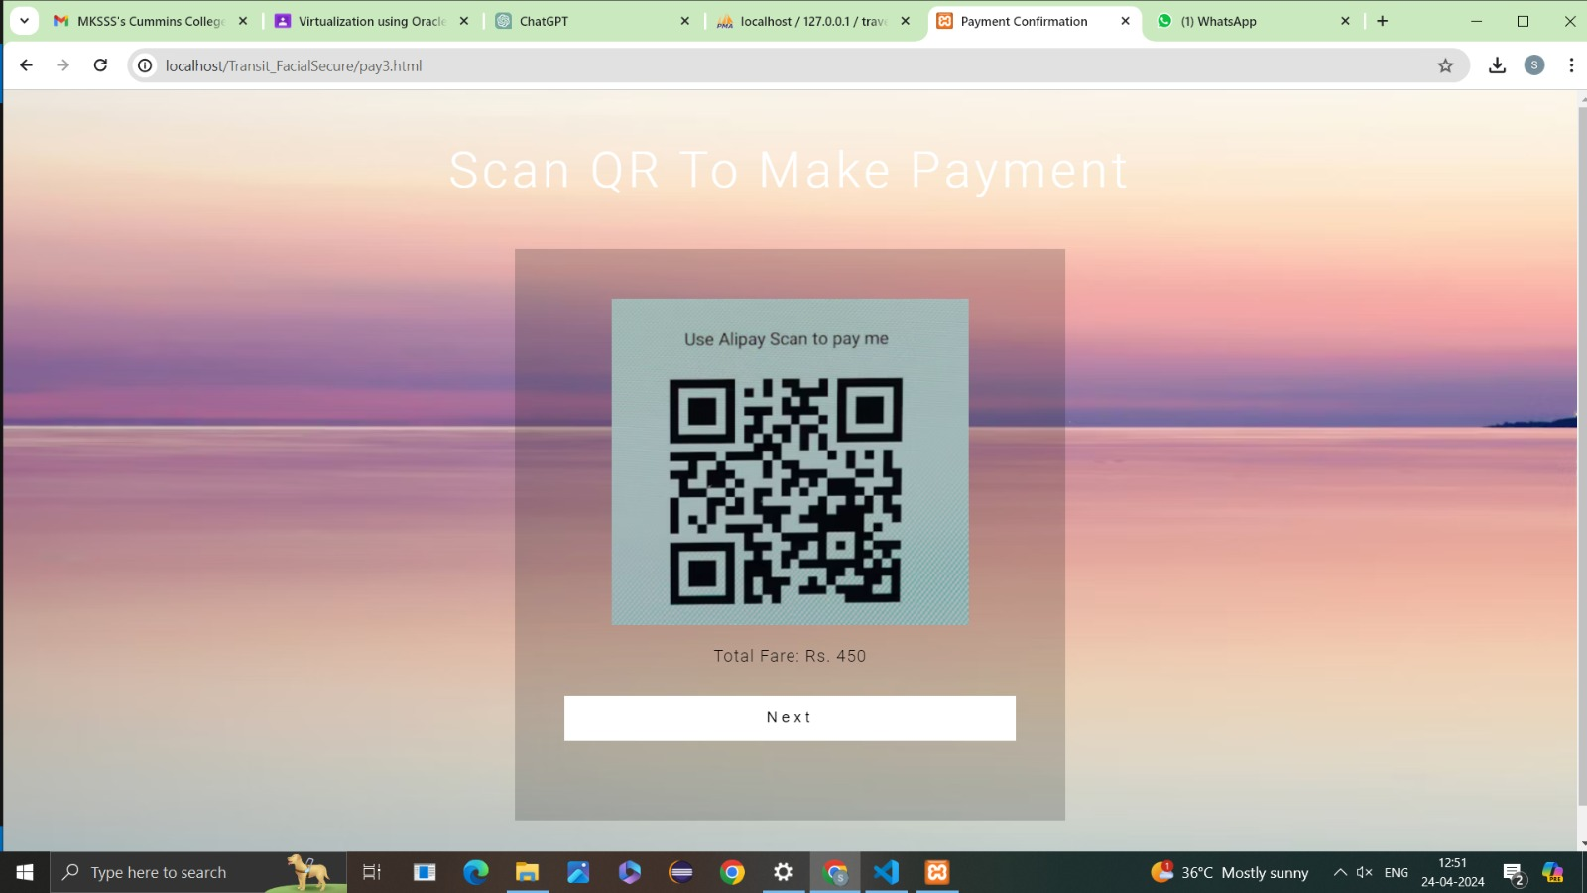
JourneyEase
Home Page
Login Page
Chatbot
Payment
Face recognized
Photo Capturing

Slide 5
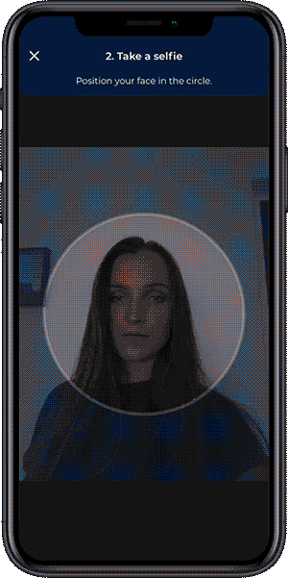
Technology Stack
Web Application Development
Html
Css,Js
Php
Face Recognition libraries
Face-api.min.js
Face_expression_models
Cloud Services
AWS
Google Cloud
Database Management
MySQL
PhpMyAdmin
Xampp control panel

Slide 6
Our Team(Code Mystics)
Group Members
Srushti Pophale
Sanika Nanavare
Shreya Jakapure
Streams
Computer Science
Electronics & Telecommunications
Electronics & Telecommunications
Year of Passing
2025
2025
2025
College Registration Numbers
UCE2022007
UEC2022019
UEC2022017
Thank You!

